Slide 1

National Innovation System: History/ Concept/Model
Based on: Emergence and Development of the National Innovation Systems Concept.

Slide 2
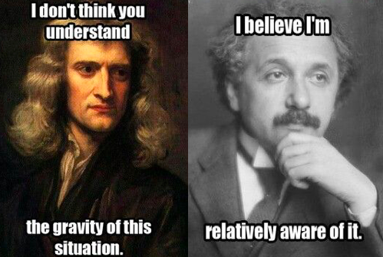
What’s Innovation
Innovation
New
First to achieve
Overall Wellbeing
Bold

Slide 3
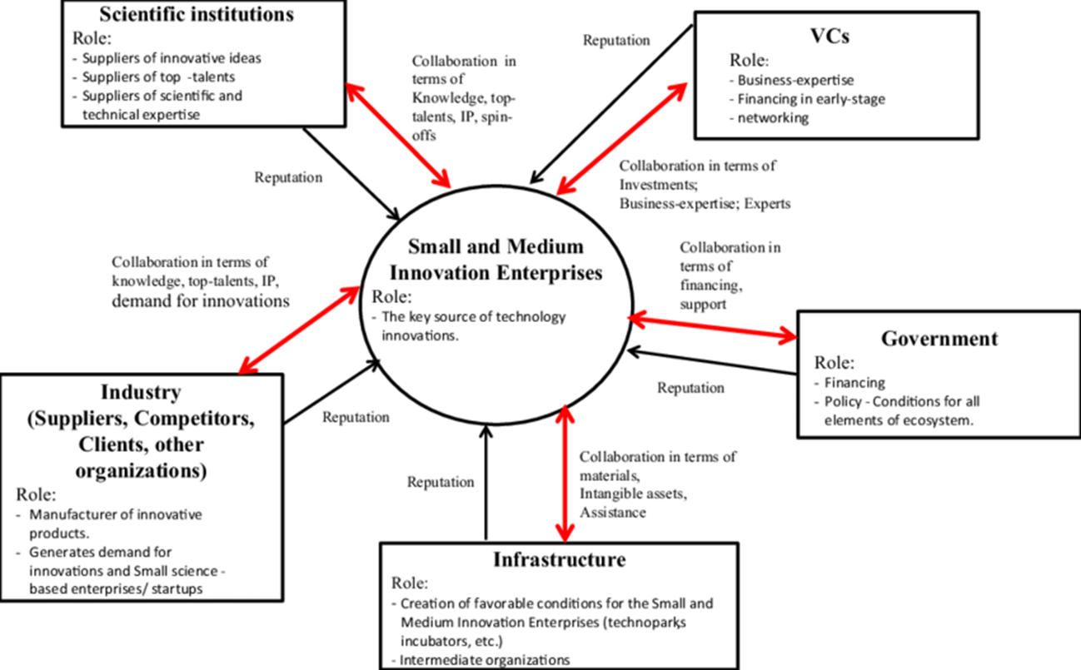
National Innovation System
Is it a concept, discipline, development mechanism?
Why is it becoming a focus of governments and a metric to judge growth and the economic well being of a society?
Is it a need or a want?
It’s the glue that joins both the public (government, Universities, Sovereign Wealth Funds) and private sector (Tech firms, Venture Capital) to diffuse and incorporate new technology
De Jong, J. P., Vanhaverbeke, W., Kalvet, T., & Chesbrough, H. (2008). Policies for open innovation: Theory, framework and cases. Tarmo Kalvet.

Slide 4
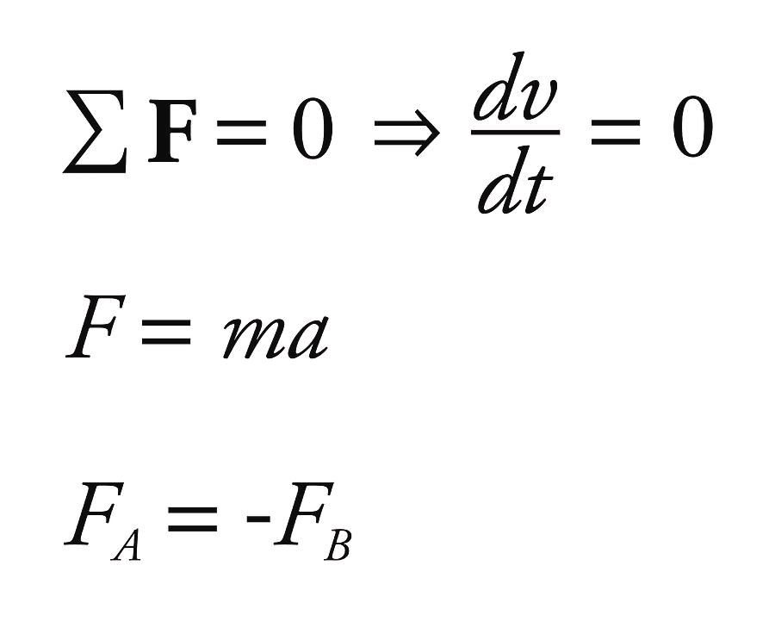
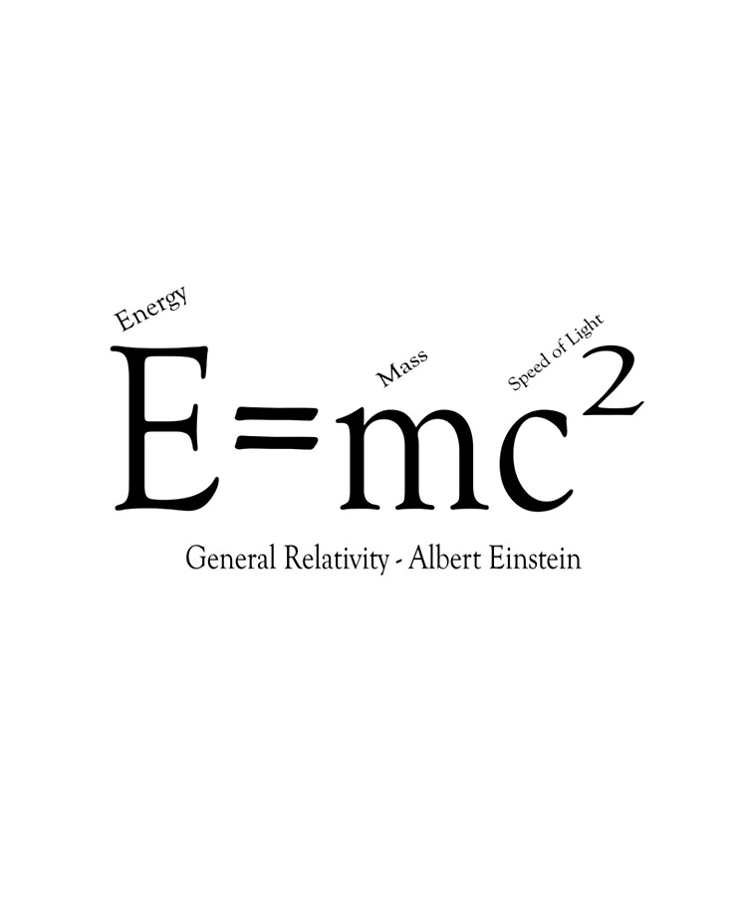
Why Analyze National Innovation System
The interaction and the influence of NIS as a concept in aiding the development and incorporation of new technology is important
But what governs and how it can be studied?
Science and Engineering is governed by a set of dogmas that are used to develop new technology
Governing Rules of Newton Laws, Thermodynamics , Relativity, etc.
Physical Products can be witnessed: Spacecraft, Cars, Computers, etc.
NIS depends on the conscious and behavior of Humans in facilitating development

Slide 5
The Eight Themes of NIS

Slide 6
Methodology of the Author
The author has taken a qualitative approach to determine the emergence & development of NIS by interviewing the researchers & scholars related to National Innovation Systems’ research
Nubahar organized the history of NIS concept around eight themes to clarify the specific circumstances surrounding the genesis of NIS concept that are missing in early research of the concept
Each of the inter-related themes either represent controversy or missing piece of NIS concepts.
The main question that this paper will address is, How National Innovation Systems condition, influence, and co-constitute policymaking practices and innovation in academics?

Slide 7
Some Key Figures of NIS
Name | Affiliation
Christopher Freeman | University of Sussex
Richard Nelson | Columbia University
Bengt-A° ke Lundvall | Aalborg University, Denmark
Charles Edquist | Lund University, Sweden
Keith Smith | Chalmers Univ. of Tech., Sweden
Franco Malerba | Universit`a Bocconi, Milan, Italy
Jean Guinet | OECD, Paris, France

Slide 8
How was it Founded?
NIS emerged in a very definite set of sociological circumstances
Social
Political
Economical
The Rise of Japan in the manufacturing industry during the 1980s
Globalization and the race of competition among nations to secure economic position
Economic Crisis in Finland from 1990 to 1993
GDP dropped 14% and unemployment increased from 3% to 20%

Slide 9
Where did it Start? (Organization or Academica)
1) Ambiguity Surrounding the academic or policymaking origins of the NIS Concept:
Both Organizations such as DSTI and academia have legitimate claim in the origination of NIS concept
But it is due to the fact that the main prominent figures of NIS occupied both academic and policymaking positions thus making it a policy making concept as stated by Keth Smith:
“The key thing about it [NIS] is that it wasn’t really developed as a theoretical concept. It wasn’t a properly elaborated conceptual apparatus. It was really developed as a policy concept”
Policymakers informing academics or the other way around?

Slide 10
When did it Start?
What launched NIS and brought into the center of action among policy makers and academics?
Lundvall states from his perspective that there were two important literatures published that launched NIS:
Dosi et al. Technical Change and Economic Theory (1988): This book studied how orthodox economic theories deals with technical change in their models (Critiquing how the models and their shortcoming in considering technical change)
Report published by the Technology/ Economy Program (TEP) in OECD in 1992
As a terminology it was initially used by Freeman in his paper published in 1982 titled “Technological Infrastructure and International Competitiveness” (Discussed the role of creation in technological innovation)
Conclusion: NIS as concept fits both worlds (policy and academia) since prominent figures occupied both worlds

Slide 11
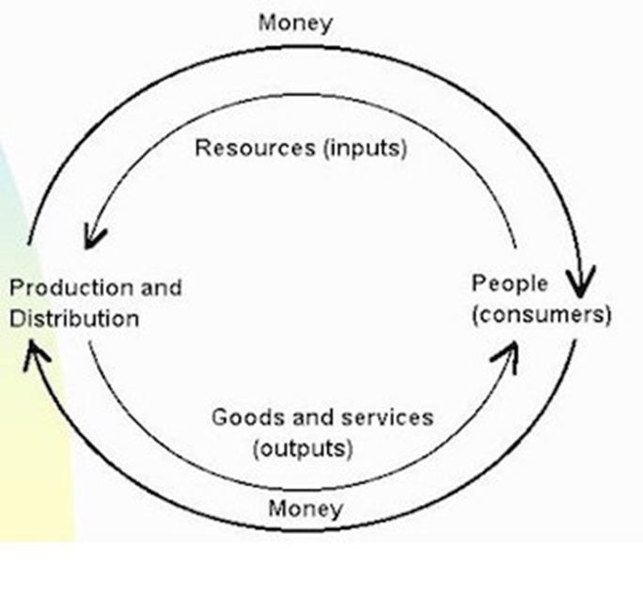
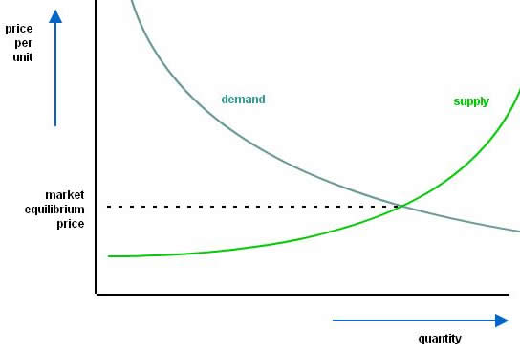
Challenging Neoclassical Model
Morgan, J. (2015). What is Neoclassical Economics?. Taylor & Francis.
2) The NIS concept as a refutation of the neoclassical economics approach to the study of Innovation:
Mainstream economics focused solely on the modelling of general equilibrium (Supply & Demand curve)
Focusses on supply and demand as the driving forces behind production, pricing, consumption of goods and services (Invisible Hand)
Main Assumptions of Neoclassical Economics:
Individual purpose is to maximize utility, while company’s purpose is to maximize profits
People act independently on perfect information.
In 1960s neo classical growth models had began to consider the effect of technical progress on growth

Slide 12
Challenging Neoclassical Model
IN 1957, SOLOW identified “residual ascribed technical change.”
Cristopher Freeman brought the concept of national systems on science, technology and competitiveness.
Freeman and Lundvall represented the reawakening of an institutional school of thought within innovation studies under the NIS banner.
Schumpeter argued against the prevailing trend among economists to define the core subject matter of economics.
“How does a economist think about knowledge and information.”
And answered the above question as:
“They don’t understand the distinction between the two very clearly.”
Meltcafe response

Slide 13
Challenging Neoclassical Model
Metcalfe’s & Lundvall Views
Lundvall questioned the neoclassical assumptions by saying:
“ My own motivation for doing this (NIS work) is dissatisfaction with standard economics.”
Neoclassical economics has limited relevance and validity towards economics.
Innovation learning explains that interdisciplinary approaches are necessary to explain economic developments.
NIS will highlight the weakness of economic system that had left out innovation in much economic literature.

Slide 14
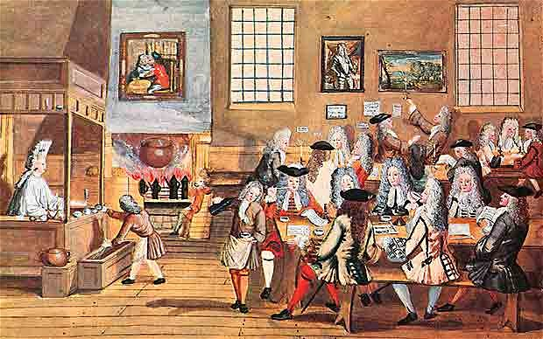
The Need for a House of Coffee for NIS
3) Formation of an NIS epistemic community:
An idea of a community composed of experts, academics, and policy makers help to construct innovative ideas related to social and technological sciences.
Conferences, workshops , and meetings gathering people of similar interests and thought
Thus, the individuals who contribute and work together in the aforementioned-domains help to formulate a community where technological sciences and political sciences go hand in hand.
Twist in NIS is the relationship between innovators of technology and public policy decision makers is of an informal nature

Slide 15
The Need for a House of Coffee for NIS
Peter Haas, a prominent figure in the fields of research and public policy making has advised a model of an epistemic society where rationality keeps evolving with the advent of knowledge.
Therefore, by thorough study of cause and effect, the theoretical framework is designed to improvise and implement final decision related to policy making.
An example of such utilization can be used to address the issue of water management and marine life
Utilization of NIS or an epistemic society measures to address and solve such issue would be inclusive to all marine life and water bodies

Slide 16
Elasticity of NIS Concept
4) Flexible Interpretations of the NIS Concept
5) Disagreement surrounding over-theorization of the NIS Concept
NIS being a new concept not governed by strict canons thus making it open to variety of interpretations
Adaptive to the national needs and constraints of various users employing it. But a familiar identity is maintained across all
The founders of this concept interpret NIS as "Different things for different people" (Lundvall. 2003) making it flexible to interpret.
Various interpretations of NIS originate mainly from two different aspects of its concept.

Slide 17
Elasticity of NIS Concept
The first approach pushed the Key figures to go beyond the limited disciplinary focus of the concept by developing a particular or special definition of the concept on which practitioners from distinct fields agree
The second approach of a flexible interpretation of NIS enhances the multidisciplinary roots of the concept by allowing the new fields of innovation studies to integrate themselves into the flux of NIS.
Such flexible interpretations of NIS concept raised differences among policy makers and academics:
Is it advantageous to choose ‘national’ unit as a principal source of study instead of regional, sectoral or technological units of Innovations systems?
Innovation system thus can take various shapes based on the diverse criteria of technological, sectorial and industrial classes

Slide 18
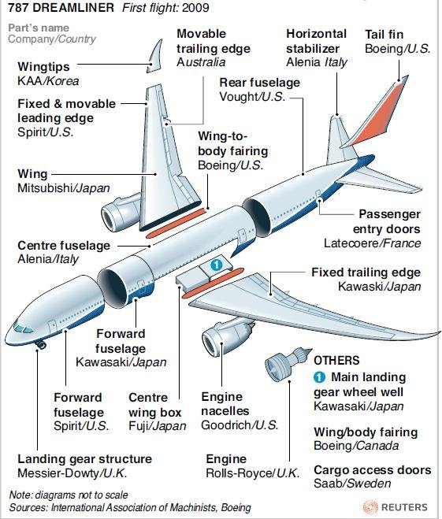
Elasticity of NIS Concept
Advocates of these new concepts argue that today’s modern innovations has crossed the national borders because of multinational domains of companies and organizations.
Globalization and cross border development
Whereas advocates of ‘national’ unit as an analytical tool,
Freeman argue that, as the ‘national’ domain best incorporates the policy dimensions of the concept, so it is beneficial to work with national units of innovation systems.

Slide 19
Extending Beyond the National Context
6) Disagreement on the presence of an NIS in all countries
7) Importance of the wider global geo-political context
NIS is multidimensional in nature as it covers the socio-political, and economic aspects of a society or a country.
The effectiveness of the NIS policies is varied depending on the condition above for each country.
As Freeman stated every country posses some sort of Innovation. While Smith argues other wise that an environment must be created for innovation to grow
Is Innovation System just about generating new technologies?

Slide 20
Extending Beyond the National Context
For example, Japan has a robust economy because of its executive geopolitical and economic strategy lead by the policies of the Japanese Ministry of International Trade and Industry (MITI)
This has attracted many Scandinavian and Northern European Countries who found the Japanese model of the economy. Thus, it made NIS swifter in its adaptation in those countries.
Economic and Status threat a method to promote innovation? (Space race in the 1950s and Industrial threat of the 1970s)
Leading in the innovation process is a teamwork game
Collaboration with other companies, educational institutes, and both public and private R&D institutes is necessary

Slide 21
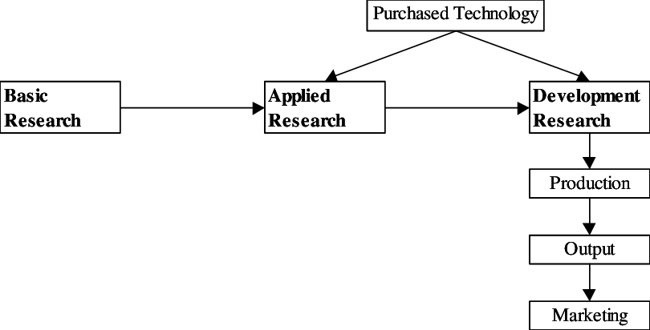
Nothing in Life is Linear
8) Refutation of the Linear Model of Innovation
Linear Model of Innovation:
It was an early model designed to understand the relationship between science and technology.
It began with basic research that flows into applied research, then development and finally production and marketing.
Jang, Y., & Vonortas, N. S. (2002). Techno-Economic Paradigm Shift and Contemporary Justification of STI Policy in Korea and the United States.

Slide 22
Nothing in Life is Linear
Metcalfe describes the Linear Model as
More systemics
More messy
And the idea of it being just a straight linear progression now began to look very questionable.
Thus raised the sterile debate about the linear model to adopt

Slide 23
Conclusion
Naubahar’s research finds that the wider environment in which NIS originated helped co-constructing the concept of NIS in various disciplines.
NIS was a boundary object coexisting in many fields simultaneously and this flexibility accelerated its acceptance and use across multiple disciplines.
The epistemic community further helped in the spread of NIS concept in smaller epistemic communities i.e. technological & sectoral innovation systems.
The concept of NIS is socially constructed as it depends upon the interpretations of different disciplines according to their choice.

Slide 24
Conclusion
Every social group pursues the concept of NIS according to the issue they encounter.
Naubahar concludes that the concept of NIS acts as a bridge between various social words irrespective of its adaptability to different circumstances and characterization of issue.
NIS maintains its integrity and coherence across distinct domains, so it doesn’t matter that which discipline defined NIS first or how it emerged.

Slide 25
References
Sharif, N. (2006). Emergence and development of the National Innovation Systems concept. Research policy, 35(5), 745-766.
Pao-Long Chang, Hsin-Yu Shih, The innovation systems of Taiwan and China: a comparative analysis, Technovation, Volume 24, Issue 7,2004
Neoclassical Economics, https://www.ecommerce-digest.com/neoclassical-economics.html
Claire A. Dunlop (2009) Policy transfer as learning: capturing variation in what decision-makers learn from epistemic communities, Policy Studies, 30:3, 289-311.
Koster, Jean & Velazco, Alec & Munz, Claus-Dieter & Krämer, Ewald & Wong, K.C. & Verstraete, Dries. (2012). Hyperion UAV: An International Collaboration. 10.2514/6.2012-1223.

Slide 26
References
Vonortas, Nicholas. (2022). Techno-Economic Paradigm Shift and Contemporary Justification of STI Policy in Korea and the United States.
Smith, K., 1997. Economic Infrastructures and Innovation Systems. In: Edquist, C. (Ed.), Systems of Innovation: Technologies, Institutions and Organizations. Pinter, London.
Trunina, Anna & Liu, Xielin & Chen, Jian. (2018). Small and medium technology enterprises in Zhongguancun and Silicon Valley: Regional innovation system approach. Journal of Science and Technology Policy Management.

